Slide 1

Suicide and poverty in low and middle income countries (LMICs)
Presenter: Miss Valentina Iemmi
Authors: Miss Valentina Iemmi, Dr Ernestina Coast, Dr Tiziana Leone, Mr David McDaid

Slide 2
What?
Relationship between suicide and poverty in LMICs
Loss of job
Reduced productivity
SUICIDE
POVERTY
Economic deprivation
Low education
Unemployment

Slide 3
How?
Systematic mapping
KEY WORDS
Databases: PubMed/Medline, Embase, PsycINFO, PsycEXTRA, ISI Web of Science, IBSS, ASSIA, PAIS, CAB Direct, EconLit, GEOBASE, ERIC, Cochrane Review, Campbell Library
Type of study: qualitative, quantitative, mixed methods, economic evaluations and modelling, reviews, and meta-analysis
Languages: English, French, Spanish, Portuguese, Italian
Publication date: 1990 – 2010
SUICIDE
(ideation-attempted-completed)
POVERTY
(monetary)
LMICs

Slide 4
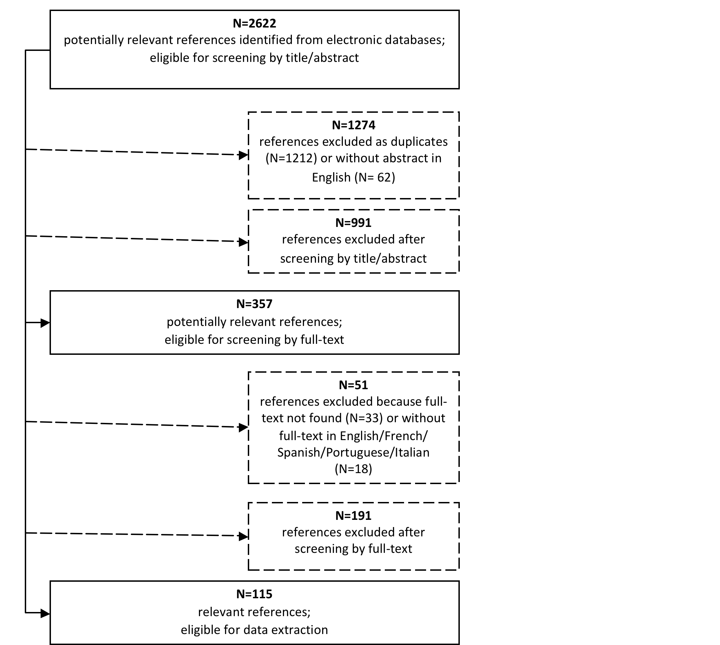
Results
Searches
Screening by title/abstract
Screening by full-text

Slide 5
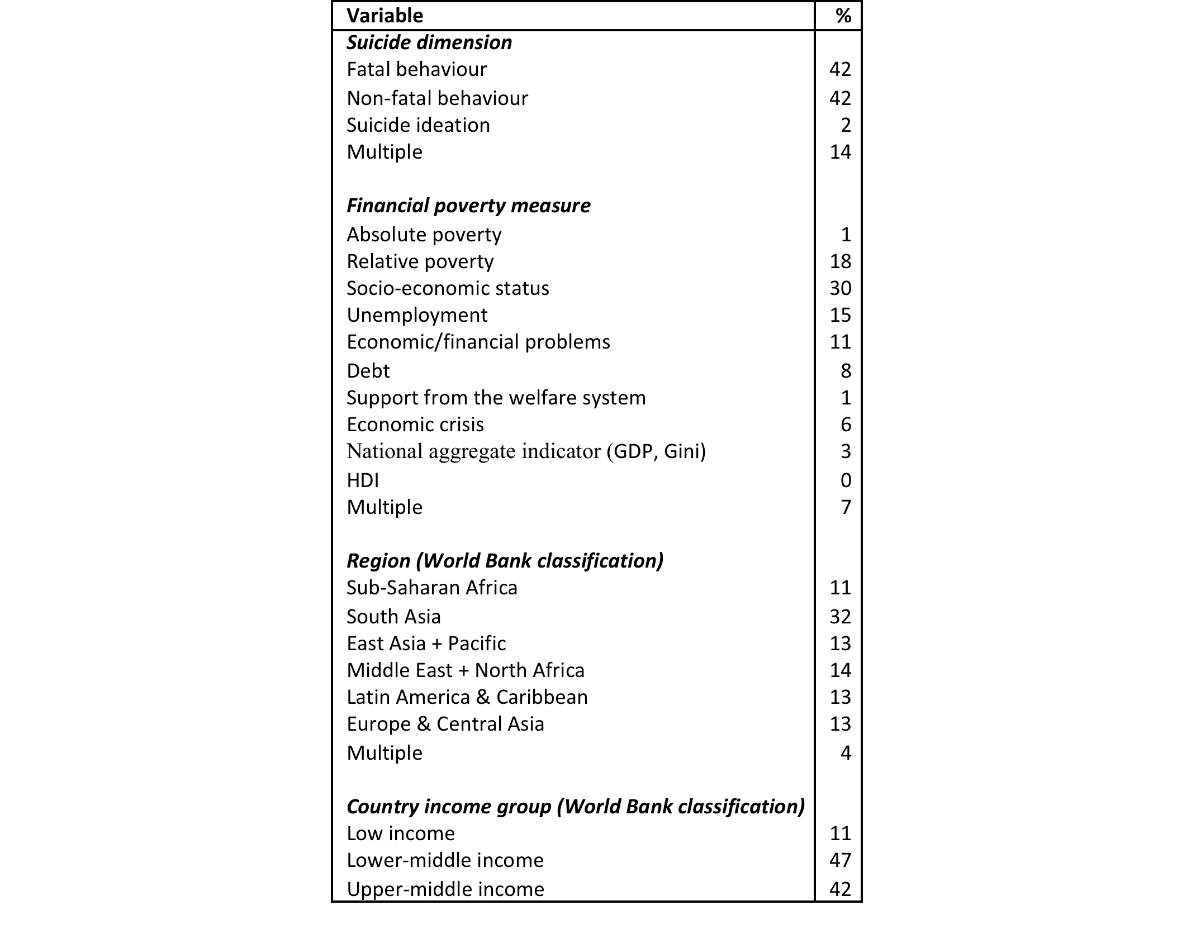
Study characteristics
Suicide dimensions
Poverty measures
Setting and study population

Slide 6
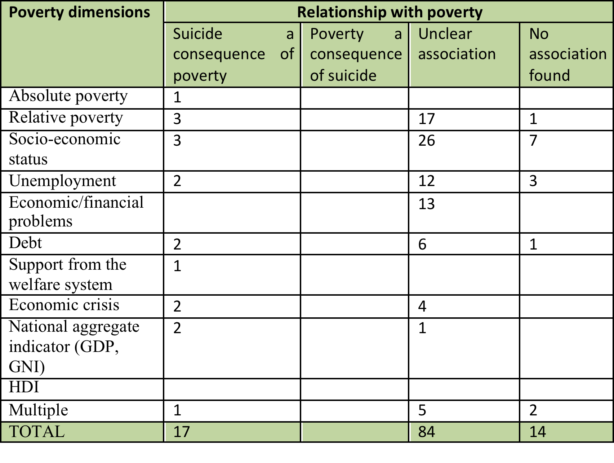
Study characteristics (cnt/d)
Suicide-poverty association

Slide 7
Causal chain
Only those studies where causality was clearly identified in the methodology:
26 which looked at the correlation between poverty and suicide
5 which used poverty as a control variable and
26 which considered poverty within a multivariate regression analysis
Only the pathways from poverty to suicide
?
SUICIDE
POVERTY
  Unemployment
  Low income
  Low income inequalities (=mass poverty)
  Debt
  Macro-economic crisis (e.g. agricultural crisis in South Asia)

Slide 8
Next steps
Robust research on suicide and poverty in LMICs
Evaluation of the impact of interventions on poverty on suicide
Evaluation of the impact of interventions on suicide on poverty

Slide 9
Thanks

